Slide 1
MODULE : COMPUTER FUNDAMENTALS

Slide 2
Week 1 : Introduction to Computing

Slide 3
🎯 Learning Objectives
By the end of this lesson, students should be able to:
Define what a computer is and explain its basic functions.
Identify and describe the major types and characteristics of computers.
Explain the generations of computers and their evolution.
Distinguish between hardware, software, and firmware.
Identify key components of a PC and describe their functions.
Produce a short documentation report describing a computer system and its components.

Slide 4
1️⃣ What is a Computer?
A computer is an electronic device that receives data (input), processes it according to a set of instructions (processing), produces information (output), and stores it for future use (storage).
Basic Definition:
A computer is an electronic machine that accepts data as input, processes it, and produces useful information as output.

Slide 5
The Basic Functions of a Computer
Function | Description | Example
Input | Receiving data and instructions | Keyboard, Mouse
Processing | Performing operations on the data | CPU operations
Output | Displaying the result of processing | Monitor, Printer
Storage | Saving data and results | Hard disk, Flash drive

Slide 6
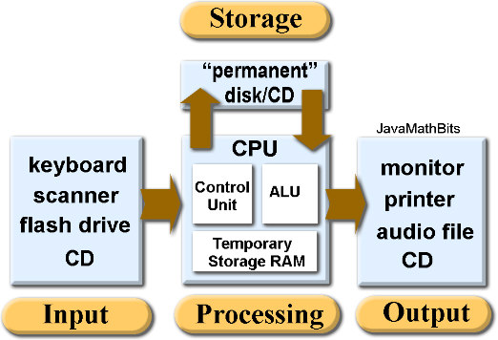
📊 Diagram

Slide 7
2️⃣ Types of Computers
Computers can be classified by size, purpose, or data processing method.
(A) By Size/Performance
Type | Description | Example
Supercomputers | Fastest and most powerful; used for complex computations | NASA systems
Mainframe Computers | Used in large organizations for bulk data | Banks, Airlines
Minicomputers | Mid-range computers for small organizations | Industrial control
Microcomputers (PCs) | Personal use, general purpose | Laptops, Desktops
Embedded Systems | Built into other devices | ATMs, Cars, Smart TVs

Slide 8
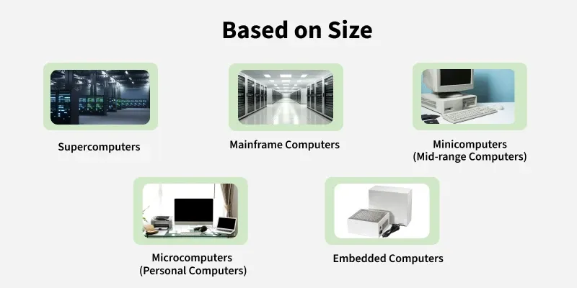

Slide 9
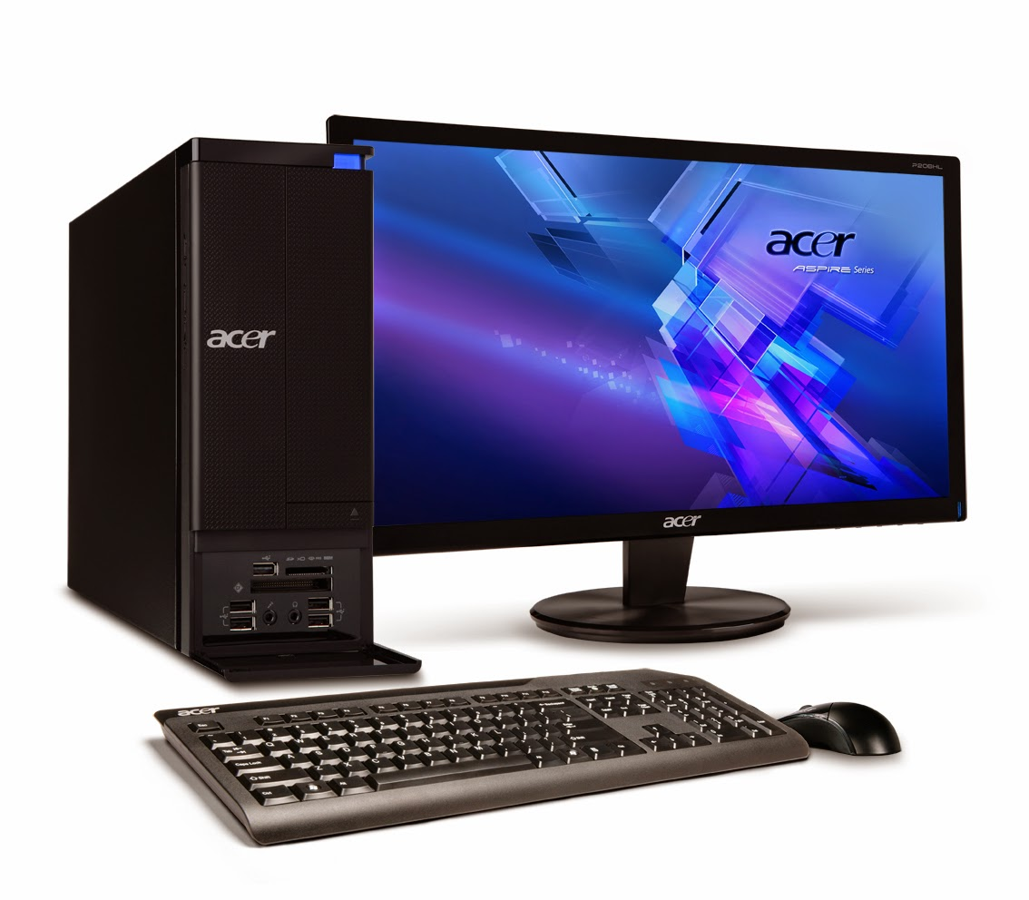
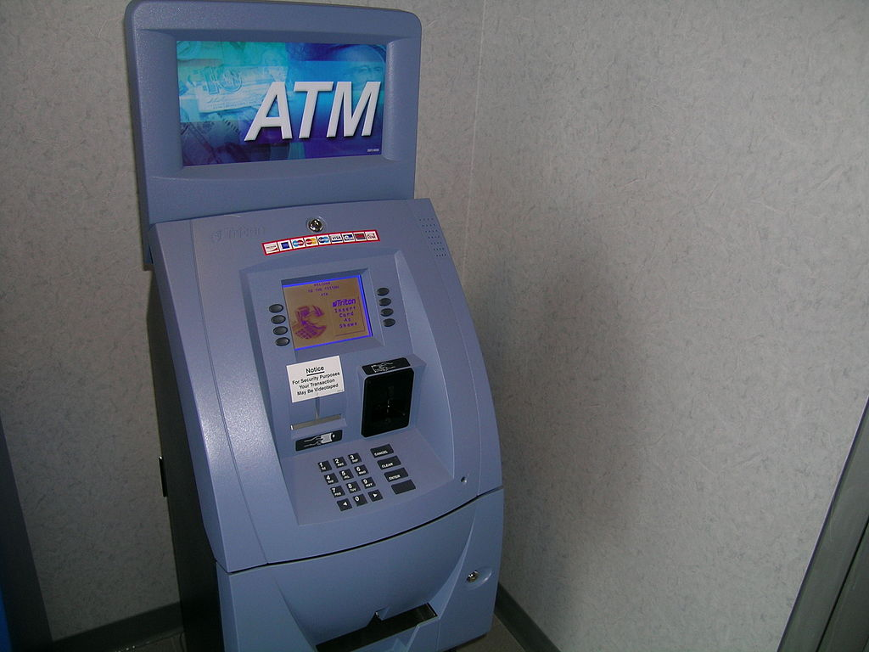
(B) By Purpose
General Purpose Computers – Handle various tasks (e.g., Word processing, gaming).
Special Purpose Computers – Designed for one specific job (e.g., ATM, car control unit).

Slide 10
3️⃣ Characteristics of Computers
Characteristic | Description
Speed | Performs millions of operations per second
Accuracy | Very precise if properly programmed
Automation | Can perform tasks automatically
Storage Capacity | Stores vast amounts of data
Versatility | Can perform different types of tasks
Diligence | Never gets tired or bored
Connectivity | Connects with other computers and devices easily

Slide 11
4️⃣ Overview of Computer Generations
Computers have evolved over time in terms of technology, speed, and size.
Generation | Period | Technology Used | Example
1st Generation | 1940–1956 | Vacuum Tubes | ENIAC, UNIVAC
2nd Generation | 1956–1963 | Transistors | IBM 7094
3rd Generation | 1964–1971 | Integrated Circuits (ICs) | IBM 360
4th Generation | 1971–Present | Microprocessors | Personal Computers
5th Generation | Present and Future | Artificial Intelligence, Quantum Computing | AI systems
📘 Note: Each generation brought smaller, faster, and more reliable computers.

Slide 12
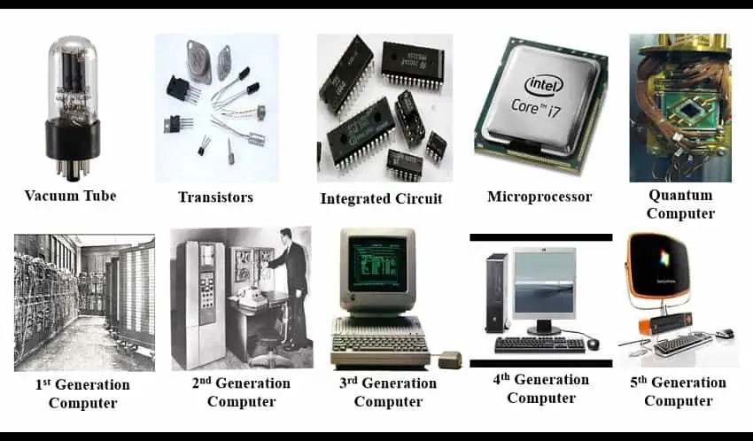

Slide 13
5️⃣ Hardware vs Software vs Firmware
Component | Description | Examples
Hardware | The physical parts of a computer that you can touch | CPU, Monitor, Mouse
Software | The set of instructions that tell the hardware what to do | Windows, MS Word
Firmware | Software that is embedded into hardware and controls its functions | BIOS, router OS

Slide 14
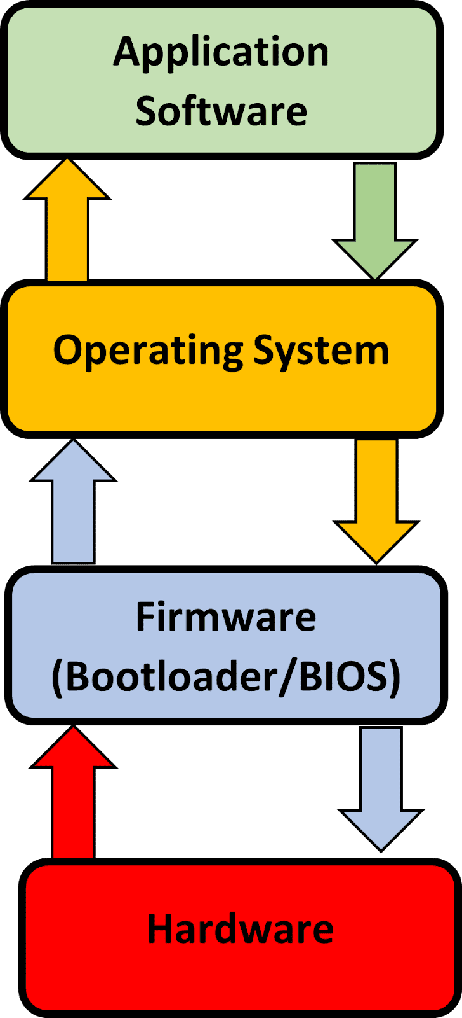

Slide 15
END OF WEEK ONE

